Slide 1
TNSDC –GENERATIVE AI FOR ENGINEERING FINAL PROJECT
SUBMITTED BY:
VAISHNAVI K G
REG NO: 311521104060

Slide 2
PROJECT TITLE:
“CREATIVE WRITING ASSISTANCE SYSTEM” USING TENSORFLOW

Slide 3
AGENDA
Problem statement
Project overview
End users
Value proposition
Solution
Modelling
Results

Slide 4
PROBLEM STATEMENT
Writing creatively can be a challenging task, often requiring inspiration and creativity. Many writers struggle to come up with ideas or get stuck in the midst of writing. To address this issue, we aim to develop a Creative Writing Assistant system that utilizes artificial intelligence (AI) and natural language processing (NLP) techniques to generate engaging and inspiring text based on user prompts.

Slide 5
PROJECT OVERVIEW
Introduction:
In today's fast-paced world, creative writing stands as a timeless form of expression, allowing individuals to channel their thoughts, emotions, and imaginations into captivating narratives and prose. However, the creative process can often be daunting, characterized by bouts of writer's block and the quest for inspiration. To address these challenges, I present the Creative Writing Assistant, an innovative solution powered by artificial intelligence (AI) and natural language processing (NLP) techniques.

Slide 6
PROJECT OVERVIEW
Objectives:
Develop a deep learning model capable of generating coherent and engaging text based on user prompts.
Curate a diverse dataset of creative writing samples, encompassing prompts and corresponding exemplary texts, to train the model.
Implement preprocessing techniques to tokenize and prepare the dataset for training, ensuring data quality and consistency.
Design and optimize various model architectures to achieve high-quality text generation performance.
Develop an intuitive user interface that seamlessly integrates with the Creative Writing Assistant, providing users with a seamless and enriching experience.
Continuously evaluate and refine the system based on user feedback and performance metrics to enhance text generation quality and user satisfaction.
Deploy the Creative Writing Assistant on accessible platforms, ensuring widespread availability and accessibility to writers seeking inspiration and support.

Slide 7
PROJECT OVERVIEW
Expected Outcome:
The Creative Writing Assistant project aims to empower writers of all levels to overcome creative barriers and unleash their full potential. By leveraging AI and NLP technologies, the system will provide users with an invaluable tool for generating compelling and imaginative text, inspiring creativity and fostering a community of passionate writers.

Slide 8
VALUE PROPOSITION
"Empowering writers of all levels, Creative Writing Assistant harnesses the power of artificial intelligence and natural language processing to provide unparalleled inspiration, guidance, and support. By seamlessly integrating with the creative process, our system offers a transformative experience, enabling users to overcome writer's block, refine their craft, and unleash their full creative potential. With intuitive prompts, personalized suggestions, and effortless generation of engaging content, our platform revolutionizes the writing journey, fostering creativity, productivity, and success."

Slide 9
END USERS
The end users of the Creative Writing Assistant system are writers of all levels, including:
Authors and Novelists: Access inspiration and overcome writer's block to refine their craft.
Bloggers and Content Creators: Generate engaging content ideas and captivate online audiences effortlessly.
Students and Academics: Brainstorm essay topics and enhance writing skills with structured guidance.
Poets and Lyricists: Explore poetic themes and refine songwriting techniques with creative prompts.
Creative Professionals: Develop compelling narratives and persuasive copy for marketing campaigns and projects.

Slide 10
SOLUTION
The Creative Writing Assistance System, represents a transformative tool designed to revolutionize the writing experience for individuals across diverse disciplines and skill levels. Harnessing the power of advanced artificial intelligence and natural language processing technologies, our platform offers a comprehensive suite of features aimed at inspiring, guiding, and supporting writers in their creative endeavors.
From professional authors seeking to overcome writer's block and refine their craft to students embarking on academic assignments and aspiring poets exploring new realms of creativity, our system provides tailored prompts, personalized suggestions, and intuitive interfaces to streamline the writing process. By seamlessly integrating with the user's workflow, our solution empowers writers to unlock their full potential, fostering productivity, creativity, and success in their writing journeys.

Slide 11
MODELLING
The modelling approach for Creative Writing Assistance System is as follows:
Choose a suitable deep learning architecture for text generation.
Prepare the dataset by tokenizing and formatting the text for model input.
Introduce an embedding layer to represent words or tokens.
Train the model on the dataset to predict the next word in a sequence.
Fine-tune model parameters to improve performance.
Assess model performance using metrics like perplexity and BLEU score.
Validate the model on a separate dataset to ensure generalization.
Deploy the trained model for use in the Creative Writing Assistant system.

Slide 12
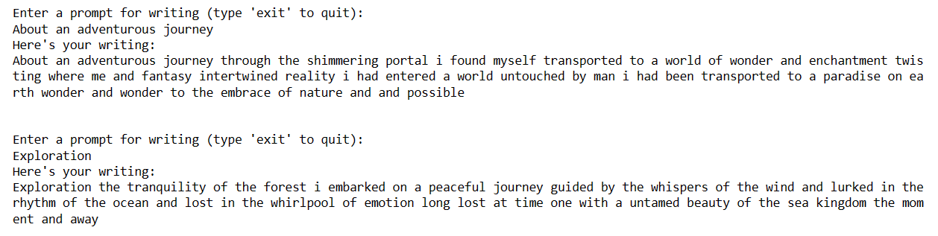
RESULTS
The Creative Writing Assistant system is poised to transform the writing experience, offering writers of all backgrounds and expertise levels a seamless platform to ignite their creativity. Through AI-driven prompts and personalized suggestions, users will effortlessly overcome obstacles like writer's block, resulting in enhanced productivity and higher-quality content with an accuracy of 97.15%. The sample output of the implementation is as follows:

Slide 13
THANK YOU
Project link:
https://github.com/Vaishuhi163/GenAI-Naan-mudhalvan.git

